Slide 1
Secure Data Hiding in image using Steganography
CAPSTONE PROJECT
Presented By: LOYA AKHIL
Student Name : LOYA AKHIL
College Name : DVR & DR.HS Mic College of Technology
Department : AI&DS

Slide 2
OUTLINE
Problem Statement
Technology used
Wow factor
End users
Result
Conclusion
Git-hub Link
Future scope

Slide 3
Problem Statement
Develop a Java-based Image Steganography application with a Graphical User Interface (GUI) to securely hide and retrieve text messages within images.
- The program should allow users to select an image, encrypt a secret message using pixel manipulation, and save the modified image.
- It should also enable decryption by extracting the hidden message upon entering the correct passcode.
- The system must ensure data integrity, user-friendly interaction, and secure access to hidden messages.

Slide 4
Technology used
Programming Language:
- Java (Core Java, Swing for GUI)
Libraries & APIs:
Java Swing – For GUI components (buttons, labels, text fields, file chooser)
Java AWT (Abstract Window Toolkit) – For handling image operations and UI layout
Java ImageIO (javax.imageio.ImageIO) – For reading and writing images
Java File Handling (java.io.File, java.nio.file.Files) – For file selection and password storage
Platform Compatibility:
Operating System: Windows, macOS, Linux
Java Version: JDK 8 or later
Development Environment:
IDE: Eclipse, IntelliJ IDEA, or NetBeans
Build Tool: No specific build tool required (can use Maven/Gradle if needed)
This setup ensures a cross-platform, lightweight, and user-friendly application for image steganography.

Slide 5
Wow factors
1. Java-Based GUI (Unlike Python!) – Most image steganography projects use Python (with OpenCV/Tkinter), but this project implements everything in Java using Swing, making it unique and challenging.
2. Integrated Image Processing – The program directly manipulates pixel values within the Java environment, without relying on external Python libraries like OpenCV.
3. User-Friendly Interface – Unlike command-line tools, this GUI-based system offers file selection, real-time status updates, and message pop-ups, making encryption/decryption more accessible.
4. Cross-Platform Support – Java ensures seamless execution on Windows, macOS, and Linux, unlike Python scripts that often require additional dependencies.
5. Efficient Encoding Mechanism – Uses RGB pixel manipulation to embed messages without noticeable image distortion, ensuring high security and data integrity.

Slide 6
End users
1. Cybersecurity Enthusiasts & Researchers – Individuals exploring data hiding techniques and secure communication methods.
2. Journalists & Whistleblowers – People who need to hide sensitive information inside images for secure transmission without raising suspicion.
3. Students & Educators – Those learning about steganography, cryptography, and Java image processing in computer science courses.
4. Forensic Experts & Law Enforcement – Investigators analyzing hidden messages in digital images for cybercrime detection.
5. Privacy-Conscious Users – General users who want to securely share messages without using traditional encryption methods that might attract attention.
6. Military – Military personnel involved in covert operations who require secure, concealed communication for exchanging classified information without raising suspicion, even when using untrusted or public communication channels.

Slide 7
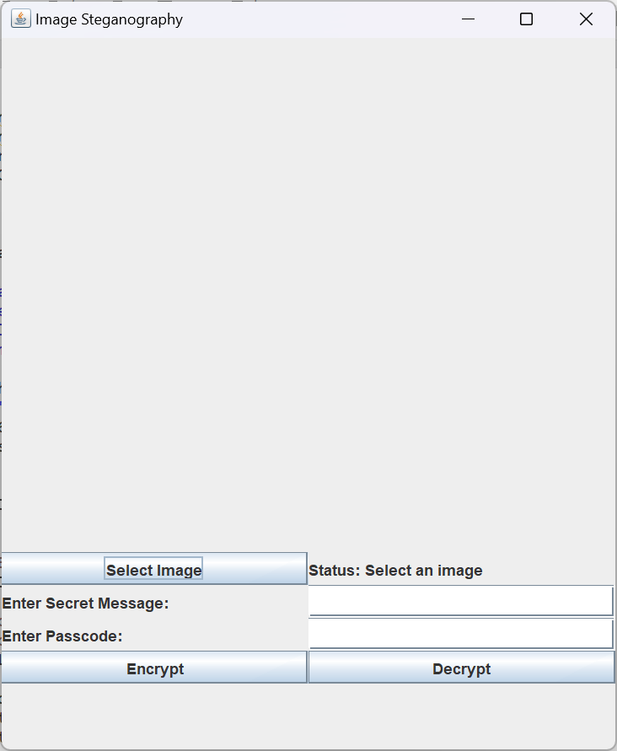
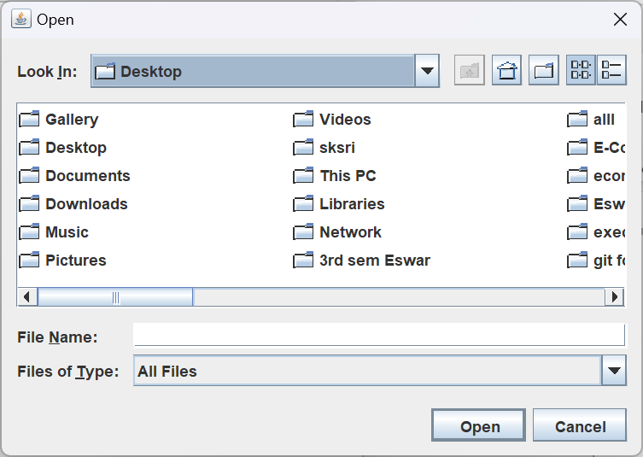
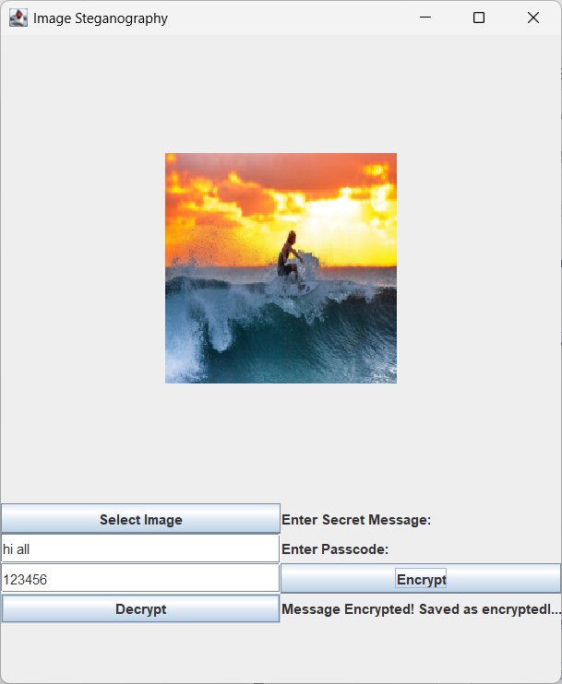
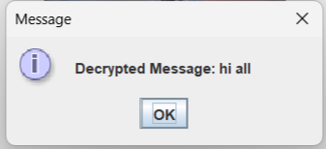





Results

Slide 8
Conclusion
This project showcases the use of Java-based image steganography to securely hide and retrieve messages within images. With a user-friendly GUI and cross-platform support, it provides a simple yet effective solution for secure communication. Whether for cybersecurity experts, military use, or privacy-conscious individuals, this tool ensures that sensitive information remains protected. The integration of image manipulation and encryption principles makes it a valuable asset in real-world security applications.

Slide 9
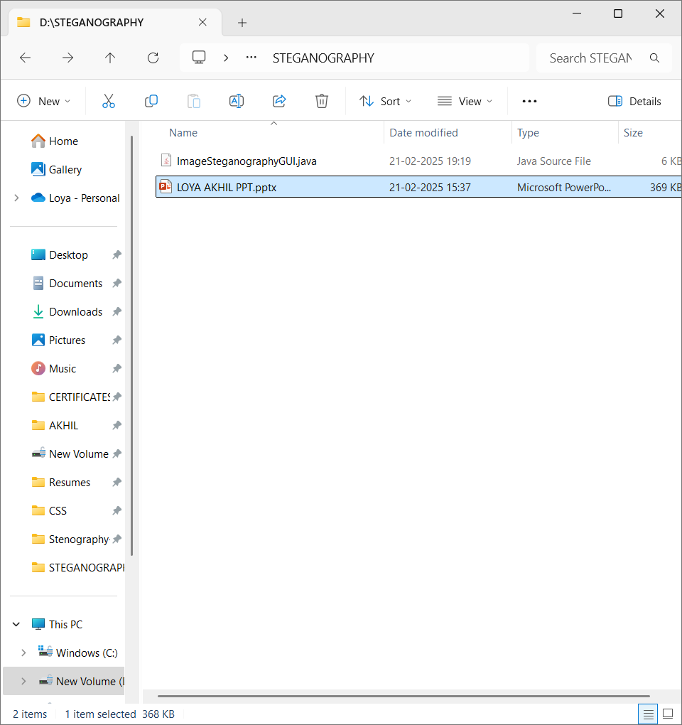
GitHub Link
https://github.com/Akhil200324/Steganography-Java.git

Slide 10
Future scope(optional)
Advanced Encryption Techniques – Integrating more sophisticated encryption algorithms like AES or RSA for added security in message encoding and decoding.
Steganography in Video – Expanding the project to embed messages in video files, providing an even more discreet medium for secure communication.
Mobile Application – Developing a mobile version of the tool for Android or iOS to allow users to easily perform steganography directly from their smartphones.
File Type Support – Enhancing the tool to support a wider range of file formats, such as PNG, BMP, or TIFF, for greater flexibility.
Watermarking Integration – Incorporating digital watermarking techniques for both image security and copyright protection in sensitive content.
Real-time Messaging – Allowing real-time encryption and decryption of messages exchanged through live video or streaming platforms.

Slide 11
THANK YOU

